Slide 1
Unit 6: Simple Linear Regression
Statistics 102 Teaching Team March 30, 2020

Slide 2
Introduction
Examining scatterplots Least squares regression Interpreting a linear model
Statistical inference in regression

Slide 3
Introduction

Slide 4
The main ideas
Linear regression provides methods for examining the association between a quantitative response variable and a set of possible predictor variables.
Linear regression should only be used with data that exhibit linear or approximately linear relationships.
Simple linear regression is used to estimate the linear relationship between a response variable y and a single predictor x .
The response variable y can be referred to as the dependent variable, and the predictor
variable x the independent variable.
The statistical model for simple linear regression is based on the straight line relationship
y = b₀ + b₁x

Slide 5
The main ideas . . .
Multiple linear regression is used to estimate the linear relationship between a response variable y and several predictors x₁, x₂, . . . , x_{p} .
The statistical model for multiple linear regression is based on
y = b₀ + b₁x₁ + b₂x₂ + · · · + b_{p}x_{p} Multiple regression will be covered in Unit 7.

Slide 6
Examining scatterplots

Slide 7
The PREVEND study
As adults age, cognitive function changes over time; largely due to various cerebrovascular and neurodegenerative changes.
The Prevention of REnal and Vascular END-stage Disease (PREVEND) study measured various clinical and demographic data for participants in a series of surveys between 1997 - 2006.
Data from 4,095 participants are in the prevend dataset in the oibiostat package.
Cognitive function was assessed with the Ruff Figural Fluency Test (RFFT), which provides information about cognitive abilities such as planning and the ability to switch between different tasks.
Scores range from 0 to 175; higher scores indicate better cognitive function.
We will work with a random sample of 500 participants.

Slide 8
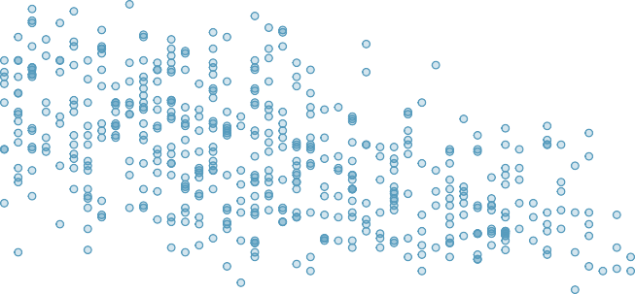
Age vs RFFT in prevend.samp
Association of RFFT Score with Age in the PREVEND data (n = 500)
20 40 60 80 100 120 140
RFFT Score
40
50
60
70
80
Age (years)

Slide 9
Age vs RFFT in prevend.samp. . .
The relationship between age and RFFT score appears linear. A line might provide a useful summary of this association.
Lab 1 steps through fitting and interpreting a line as well as evaluating whether the assumptions for linear regression are satisfied.

Slide 10
Assumptions for linear regression
There are 4 assumptions that should be satisfied for a line to be considered a reasonable approximation for a relationship shown in a scatterplot.
Linearity: the data show a linear trend.
Constant variability: the variability of the response variable about the line remains roughly constant as the predictor variable changes.
Independent observations: the (x, y ) pairs are independent; i.e., values of one pair provide no information about values of other pairs.
Approximate normality of residuals: definition coming later. . .
Special plots for formally evaluating these assumptions are discussed in the next section.

Slide 11
Least squares regression

Slide 12
Residuals in linear regression
The vertical distance between a point in the scatterplot and the predicted value on the regression line is the residual for the point.
For an observation (x_{i}, y_{i} ), where yˆ_{i} is the predicted value according to the line
yˆ = b₀ + b₁x , the residual is the value
e_{i} = y_{i} − yˆ_{i}

Slide 13
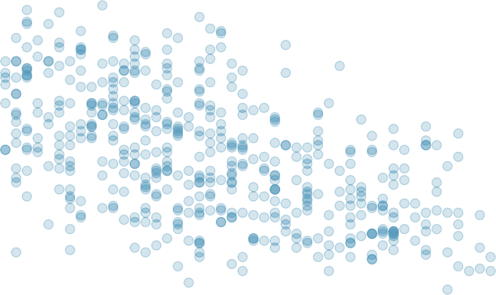
Residuals in linear regression. . .
140
120
100
80
60
40
20
RFFT Score
40
50
60
Age (yrs)
70
80

Slide 14
Estimating a line using least squares
The least squares regression line is the line which minimizes the sum of the squared residuals for all the points in the plot.
In other words, the least squares line is the line with coefficients b₀ and b₁ such that the quantity
2 2 2
e + e + · · · + e
1 2 n
is the smallest, where n is the number of data points.

Slide 15
Statistical model for least squares regression
For a general population of ordered pairs (x, y ), the population regression model is
y = β₀ + β₁x + E,
where E ∼ N(0, σ).
The error term E can be thought of as a population parameter for the residuals (e).
Since the mean of E is 0, the population model can also be written as
E (Y |x ) = β₀ + β₁x,
where E (Y |x ) denotes the expected value of Y when the predictor variable has value x .

Slide 16
Coefficients of the line in least squares regression
The terms β₀ and β₁ are parameters with estimates b₀ and b₁. These estimates can be calculated from summary statistics.
b₁ = r ^{sy} b₀ = y − b₁x s_{x}
x , y : sample means of x and y .
s_{x} , s_{y} : sample standard deviations of x and y . r : correlation between x and y .

Slide 17
Using R to calculate a least squares line
lm(prevend.samp$RFFT ~ prevend.samp$Age)$coef
## ##
(Intercept) prevend.samp$Age 137.549716 -1.261359
The least squares line can be written as
R_FFT = 137.55 − (1.26)(Age)

Slide 18
Checking assumptions with residual plots
The assumptions in linear regression are linearity, constant variability, independent observations, and approximate normality of residuals.
The independence assumption has to be checked by considering study design.
The other assumptions can be examined using residual plots and normal probability plots.
Residual plots: scatterplots in which predicted values are on the x -axis and residuals are on the y -axis
Normal probability plots: theoretical quantiles for a normal versus observed quantiles

Slide 19
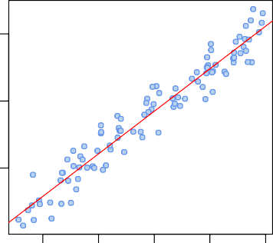
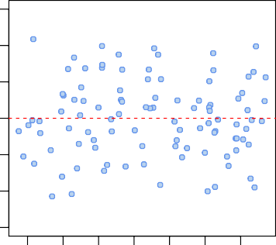
Checking linearity and constant variability
Y versus X
Residual Plot of Y versus X
20 30
150
−10 0 10
100
residual
y
50
−30
2
4
6
8
10
20 40 60 80 100
140
x
predicted value

Slide 20
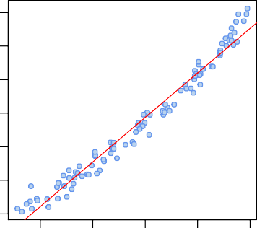
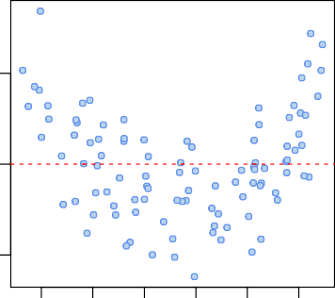
Checking linearity and constant variability. . .
Y versus X
Residual Plot of Y versus X
500
50
residual
y
300
0
100
−50
0
2
4
6
8
10
0 100 200 300 400 500
x
predicted value

Slide 21
Checking normality of the residuals
Normality of the residuals is fundamental to the underlying model
y = β₀ + β₁x + E,
since E is assumed to be nomally distributed with mean 0 and standard deviation σ. Normality of the residuals is checked using normal probability plots.
These plots were used to check the normality assumption in ANOVA.
Normal probability plots are discussed in OI Biostat Section 3.3.7.

Slide 22
Interpreting a linear model

Slide 23
Categorical predictors with two levels

Slide 24
Categorical predictors with two levels
Although the response variable in linear regression is necessarily numerical, the predictor may be either numerical or categorical.
Simple linear regression only allows for categorical predictor variables with two levels.
Examining categorical predictors with more than two levels requires multiple linear regression.
Fitting a simple linear regression model with a two-level categorical predictor is analogous to comparing the means of two groups, where the groups are defined by the categorical variable.

Slide 25
FAMuSS: comparing ndrm.ch by sex
Let’s re-examine the association between change in non-dominant arm strength after resistance training and sex in the FAMuSS data.
Change in ND Arm Strength by Sex
250
Change in non−dominant arm strength (%)
200
150
100
50
0
Female
Male
famuss$sex

Slide 26
FAMuSS: comparing ndrm.ch by sex. . .
#calculate mean ndrm.ch in each group
tapply(famuss$ndrm.ch, famuss$sex, mean)
## Female Male ## 62.92720 39.23512
#fit a linear model of ndrm.ch by sex
lm(famuss$ndrm.ch ~ famuss$sex)$coef
## (Intercept) famuss$sexMale ## 62.92720 -23.69207
nd_rm.ch = 62.93 − 23.59(sexMale)
The intercept is the mean of one category, the baseline category.
The slope is the difference between the means.

Slide 27
Using R² to describe the strength of a fit

Slide 28
The quantity R²
The correlation coefficient r measures the strength of the linear relationship between two variables.
It is more common to use r ² to measure the strength of a linear fit, which is written as R²
in the context of regression.
R² describes the amount of variation in the response that is explained by the least squares line.
_{R2 =} variance of predicted y -values ₌ Var(yˆ_{i} ) . variance of observed y -values Var(y_{i} )
If a linear model perfectly captured the variability in the observed data, then Var(yˆ_{i} ) would equal Var(y_{i} ) and R² would be 1.

Slide 29
The quantity R². . .
R² can also be calculated using the following formula:
_{R2 =} variance of observed y -values − variance of residuals ₌ Var(yi ) − Var(ei ) variance of observed y -values Var(yi )
The variability of the residuals about the line represents the remaining variability after the model is fit.
In other words, Var(e_{i} ) is the variability unexplained by the model.
Lab 4 explores the idea behind R² and provides an example of using R² to assess the strength of a model fit.

Slide 30
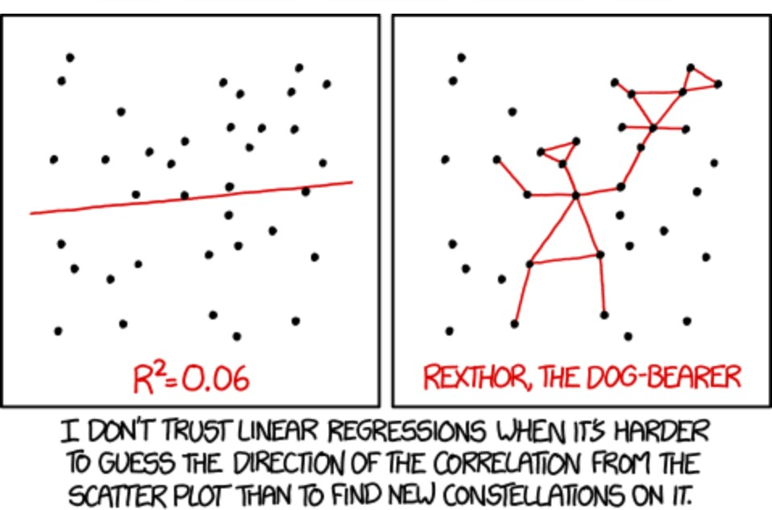
xkcd does regression

Slide 31
Outliers in regression

Slide 32
Outliers in regression
Depending on their position, data points in a scatterplot have varying degrees of contribution to the estimated coefficients of a regression line.
Points with particularly high or low values of the predictor are said to have high leverage, and have a large effect on b₀ and b₁.
A data point is considered a regression outlier if its value for the response variable does not follow the general linear trend in the data.
If an observation has a strong effect on the estimated coefficients, such that the estimates change substantially when the observation is omitted, it is considered influential.
Outliers with high leverage may be influential.
Advanced courses in regression have formal definitions for these terms.
For the purposes of Stat 102, it is important to simply be able to identify influential points and comment on whether it might be best to exclude them from the data.

Slide 33
Infant mortality and number of doctors
The following slide shows a scatterplot of infant mortality versus number of doctors, where the observations are for each state and the District of Columbia.¹
Infant mortality is measured as number of infant deaths in the first year of life per 1,000 births.
Number of doctors is recorded as number of doctors per 100,000 members of the population.
¹Data from US Census Records, 2010. Available in the oibiostat package as the census.2010
dataset.

Slide 34
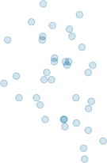
Infant mortality and number of doctors. . .
Infant Mortality by Number of Doctors (2010)
9 10 11
Infant Mortality
8
7
6
5
200
300
400 500 600
Doctors (per 100,000 members of pop.)
700
800
The red line is the model fit to all 51 observations.
The green line is the model fit to 50 observations, excluding the red point.
34 / 40

Slide 35
Infant mortality and number of doctors. . .
#identify the influential point
census.2010$state[census.2010$doctors > 700]
## [1] "District of Columbia"
The point marked in red corresponds to the District of Columbia, where there were approximately 800 doctors per 100,000 members of the population, and the infant mortality rate was 11.3 per 1,000 live births.
This observation has high leverage, since 800 is a high value for the predictor variable, number of doctors.
This observation is an outlier, since it has an unusually high y -value paired with a high x -value; the other points show a negative association where higher x -values tend to have low y -values.
The observation is influential; its inclusion substantially affects the estimated coefficients, reversing the sign of the slope.

Slide 36
Statistical inference in regression

Slide 37
The model for statistical inference
The observed data (x_{i} , y_{i} ) are assumed to have been randomly sampled from a population where the explanatory variable X and the response variable Y follow a population model
Y = β₀ + β₁X + E,
where E ∼ N(0, σ).
Under this assumption, the slope and intercept of the regression line, b₀ and b₁, are estimates of the population parameters β₀ and β₁.

Slide 38
Hypothesis testing in regression
Inference in a regression context is usually about the slope parameter, β₁. The null hypothesis is most commonly a hypothesis of ‘no association’:
H₀ : β₁ = 0, the X and Y variables are not associated
H_{A} : β₁ /= 0, the X and Y variables are associated
The t-statistic has degrees of freedom n − 2, where n is the number of ordered pairs in the dataset.
0
b − β b₁
t =
1
1 ₌
s.e.(b₁) s.e.(b₁)
The value β⁰ equals 0 when the null hypothesis is one of no association.
1

Slide 39
Confidence intervals in regression
A 95% confidence interval for β₁ has the following formula
b₁ ± (t* × s.e.(b₁)) ,
where t* is the point on a t-distribution with n − 2 degrees of freedom and α/2 area to the right.

Slide 40
The standard errors of b₀ and b₁
Formulas for calculating the standard errors of the model coefficients are in Section 6.4 of OI Biostat.
In practice, statistical software like R is used to obtain t-statistics and p-values for linear models.

